Slide 1






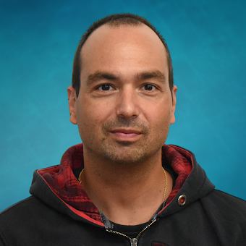




Enabling Scientific Discovery: Harnessing the Power of the National Science Data Fabric for Large-Scale Data Analysis (Session III & IV)
Presenters: Aashish Panta², Amy Gooch², Jack Marquez¹, Valerio Pascucci², and Michela Taufer¹
Assistants: Heberth Martinez¹
Other contributors: Nina McCurdy³, David Ellsworth³, Patrice Klein⁴, Hector Torres⁴, Paula Olaya¹, Gabriel Laboy¹, Jay Ashworth¹, Lauren Whitnah¹, and Giorgio Scorzelli²
¹University of Tennessee Knoxville, ²University of Utah, ³NASA Ames Research Center, ⁴NASA Jet Propulsion Lab

Slide 2

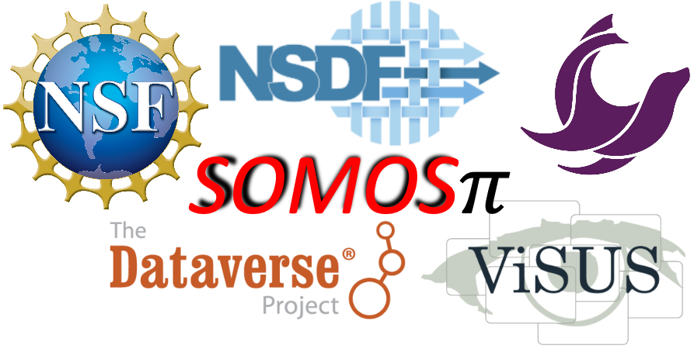


Acknowledgments
The authors of this tutorial would like to express their gratitude to:
NSF through awards 2138811, 2103845, 2334945, 2138296, and 2331152
Dataverse
Seal Storage
Rodrigo Vargas, Vargas Lab, University of Delaware
Werner Sun, CHESS, Cornell University
DOE SBIR Phase II award DE-SC0017152
Any opinions, findings, conclusions, or recommendations expressed in this material are those of the author(s) and do not necessarily reflect the views of the National Science Foundation.

Slide 3

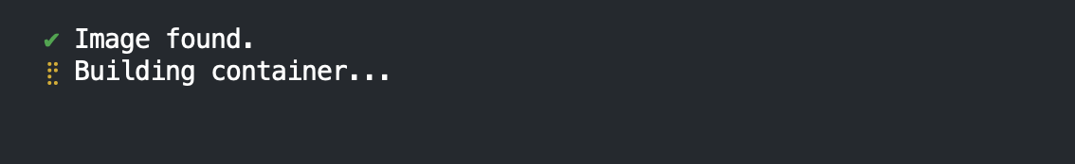
Prerequisites
Step 0: Access to GitHub
Step 1: Create Codespaces
To run this tutorial, you need to have a GitHub account.
You can create one following the instructions here:
https://docs.github.com/en/get-started/start-your-journey/creating-an-account-on-github#
Now you can login into GitHub
https://github.com/login
Use your GitHub account to run this tutorial with GitHub codespaces
Access this link: NSDF Tutorial 2024
Click on green button “Create codespace”
Notes:
Slides: https://docs.google.com/presentation/d/1iretit986m5EOL92UIf07UHQ-BGB5dkL/edit?usp=sharing&ouid=105842431565169409843&rtpof=true&sd=true Creation of Github Account: https://docs.github.com/en/get-started/start-your-journey/creating-an-account-on-github#
Github Login: https://github.com/login
Prerequisites: https://github.com/nsdf-fabric/NSDF_Tutorial/blob/main/README.md#prerequisites
README: https://github.com/nsdf-fabric/NSDF_Tutorial Creation of the github codespaces: https://codespaces.new/nsdf-fabric/NSDF_Tutorial

Slide 4

Session III
Tutorial
Step 1: Create Codespaces
Use your GitHub account to run this tutorial with GitHub codespaces
Access this link: NSDF Tutorial 2024
Click on green button “Create codespace”

Slide 5
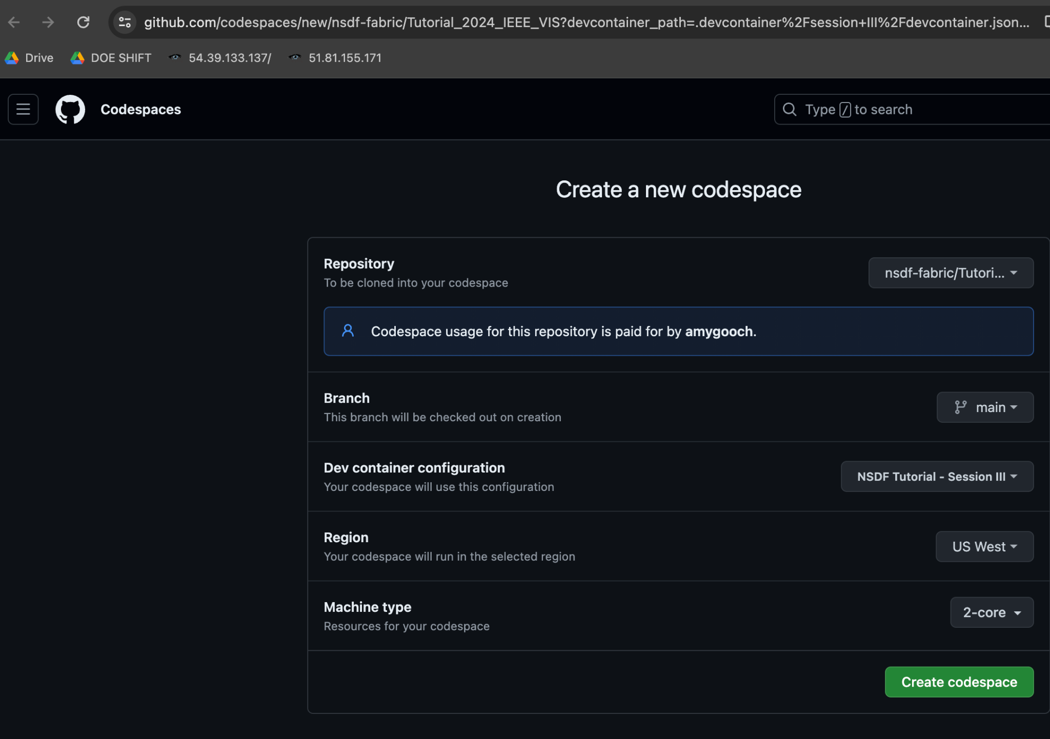
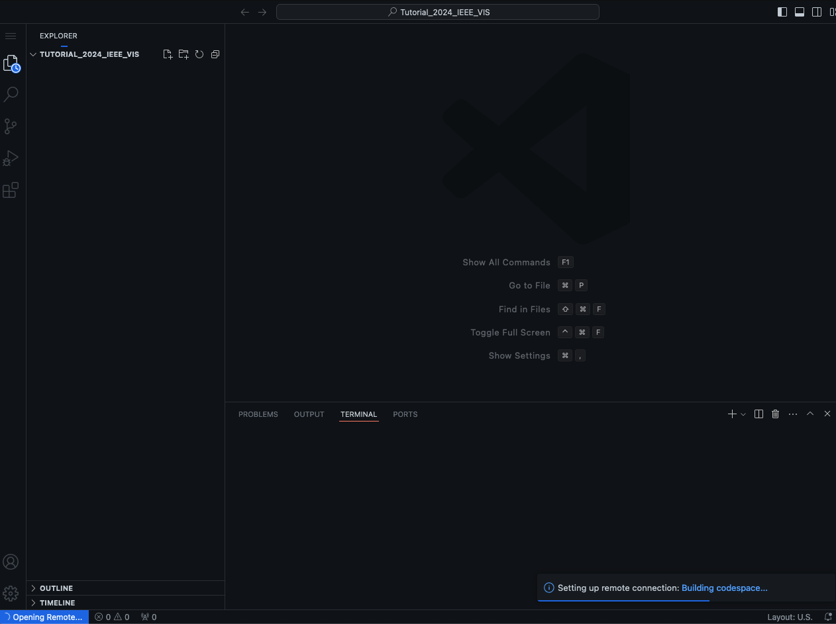
Creating the GitHub Codespace
Tutorial
Then, you should see the GitHub codespaces starting
Click this button ->
Let’s start: NSDF Tutorial 2024
Loading GitHub Codespace can take from 1 to 5 minutes

Slide 6
Tutorial Session III Goals
Tutorial
This tutorial demonstrates end-to-end analysis of scientific data through NSDF services
Tutorial
Goals
Access publicly available petascale datasets
Treat the data as a NumPy array and perform statistical analysis
Store your data for large-scale data access, visualization, analysis, and sharing

Slide 7

Session III: Petascale Data
NASA makes big datasets available
What does it mean to get to that data?
What do you have to do to see it
As a domain expert, such as a climate scientist, geographer?
As a visualization expert?
As a student?

Slide 8
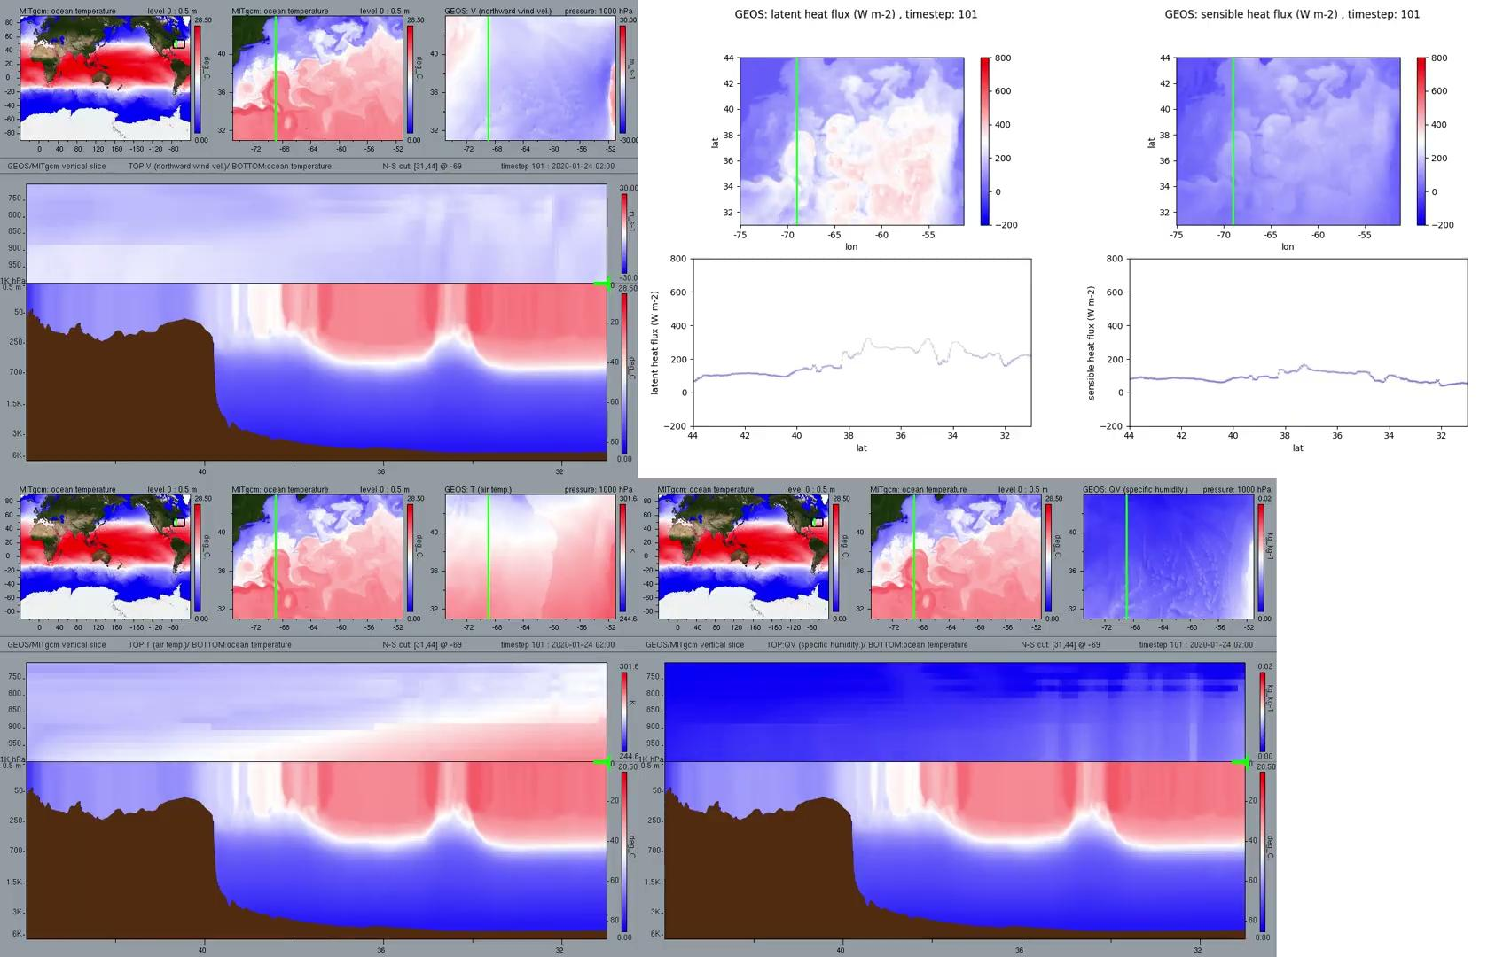
NASA Scientists and Experts in Vis and Climate
Difficulty accessing the full data
Limitations in computational power
Need real-time processing capabilities
Images/Video Copyright NASA and Nina McCurdy, used with permission.
Notes:
Animation created at NASA Advanced Supercomputing (NAS) facility on the supercomputer Pleides by visualization researchers at NASA Ames Research Center in collaboration with the ocean scientists at JPL/Caltech. Images/Video Copyright NASA and Nina McCurdy, used with permission.
Although NAS supports and promotes full and open data access to the public, analyzing the data on the supercomputers requires logging into secure platforms and requesting nodes/cores.
This dramatically limits the people who may be able to use the data in practice. Scientists and researchers might need to wait hours to days to load the data and produce a video clip for climate scientists, who then perform their scientific tasks on these fixed-resolution animations. Because supercomputing centers often store only full-resolution simulation data, accessing full-domain, full-resolution simulation data can take time, making quick turnaround on-the-fly analysis complex or slow. However, our innovative dashboard and analytical approach significantly streamline working with massive datasets, such as those often encountered in climate science. We reduce the need for extensive computing resources, allowing the analysis to be performed on more accessible platforms without compromising accuracy. Users can bypass the inconvenient process of logging into secure platforms and waiting for supercomputer access. Instead, they can directly engage with the data through our user-friendly interface that offers real-time analysis and visualization capabilities.

Slide 9
Publicly available NASA Datasets
Datasets :
NASA 1.8 PB DYAMOND dataset¹:
a global atmospheric model and a global ocean model
LLC4320 2.8 PB Ocean dataset²
https://gmao.gsfc.nasa.gov/global_mesoscale/dyamond_phaseII/data_access/
https://www.ecco-group.org/data.html
Notes:
We will demonstrate cloud access to petascale datasets such as NASA Climate datasets:
1) the NASA 1.8 PB DYAMOND dataset~\cite{stevens2019dyamond, NASADYAM} and
2) the LLC4320 Ocean dataset~\cite{menemenlis2021pre, fukumori2017ecco}.
DYAMOND is the simulation output from research into coupling two models: a global atmospheric model and a global ocean model that were originally designed to be run separately. The atmospheric model is a C1440 configuration of the Goddard Earth Observing System (GEOS) atmospheric model running on a cubed-sphere grid.
The global ocean model is an LLC2160 configuration of the MITgcm model that uses a lat-lon-cap grid (\url{https://www.ecco-group.org/data.html}).
Each model was run for over 10000 hourly timesteps covering over 14 simulation months. The atmospheric model output has 20 3D and over 100 2D scalar fields, and the ocean model output has 5 3D and 15 2D fields. Both models have 3D fields such as temperature, north-south velocity, and east-west velocity. Some example fields from the atmospheric model are humidity, soil wetness, snow cover, and various cloud state variables. The ocean model includes fields of salinity, sea ice thickness, and freshwater flux, with a total size of approximately 1.8 petabytes.
Users will have the ability to use the Jupyter Notebook for the interactive visualization shown above of sea-surface temperature demonstrated using the LLC2160 ocean dataset~\cite{NASA_DYAMOND} and inset for selecting the regions of interest (left). The dashboard provides the ability to directly download the data locally or to download a Python script that fetches the region from a cloud (right).

Slide 10



How big is a petabyte?
1,000 ^ 5 = 1,000 x 1,000 x 1,000 x 1,000 x 1,000 = 1,000,000,000,000,000 bytes
11,000 4k Movies
over 2.5 years of non-stop binge watching to get
thru a petabyte of 4k movies
92 football fields of 1GB flash drives put end to end
1 PB is equivalent to taking over 4,000 digital photos per day, over your entire life.

Slide 11
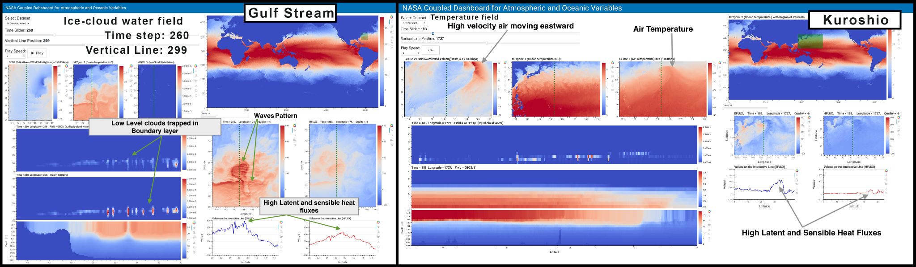
Cloud served optimized data with local caching
Aashish Panta,Xuan Huang, Nina McCurdy, David Ellsworth, Amy A. Gooch, Giorgio Scorzelli, Hector Torres, Patrice Klein, Gustavo A. Ovando-Montejo, Valerio Pascucci.
“Web-based Visualization and Analytics of Petascale data: Equity as a Tide that Lifts All Boats”. LDAV 2024
Notes:
Collaborators at Univerisity of Utah in conjunction with researchers at NASA Ames Research Center and NASA Jet Propulsion Lab, have built several application-specific dashboards
This region-specific approach allows scientists to observe how atmospheric conditions such as temperature and pressure gradients influence oceanic currents, salinity levels, and vertical velocities, and vice versa.
Figure~\ref{fig:gulf_usecase} shows how an investigation into an
interesting wave pattern observed in the plots of sensible and latent heat flux (middle)
and examination of the associated vertical slices led the ocean scientists to find that the wave pattern was trapped within the atmospheric boundary layer (left) and did not extend above the boundary layer, as previously thought.

Slide 12
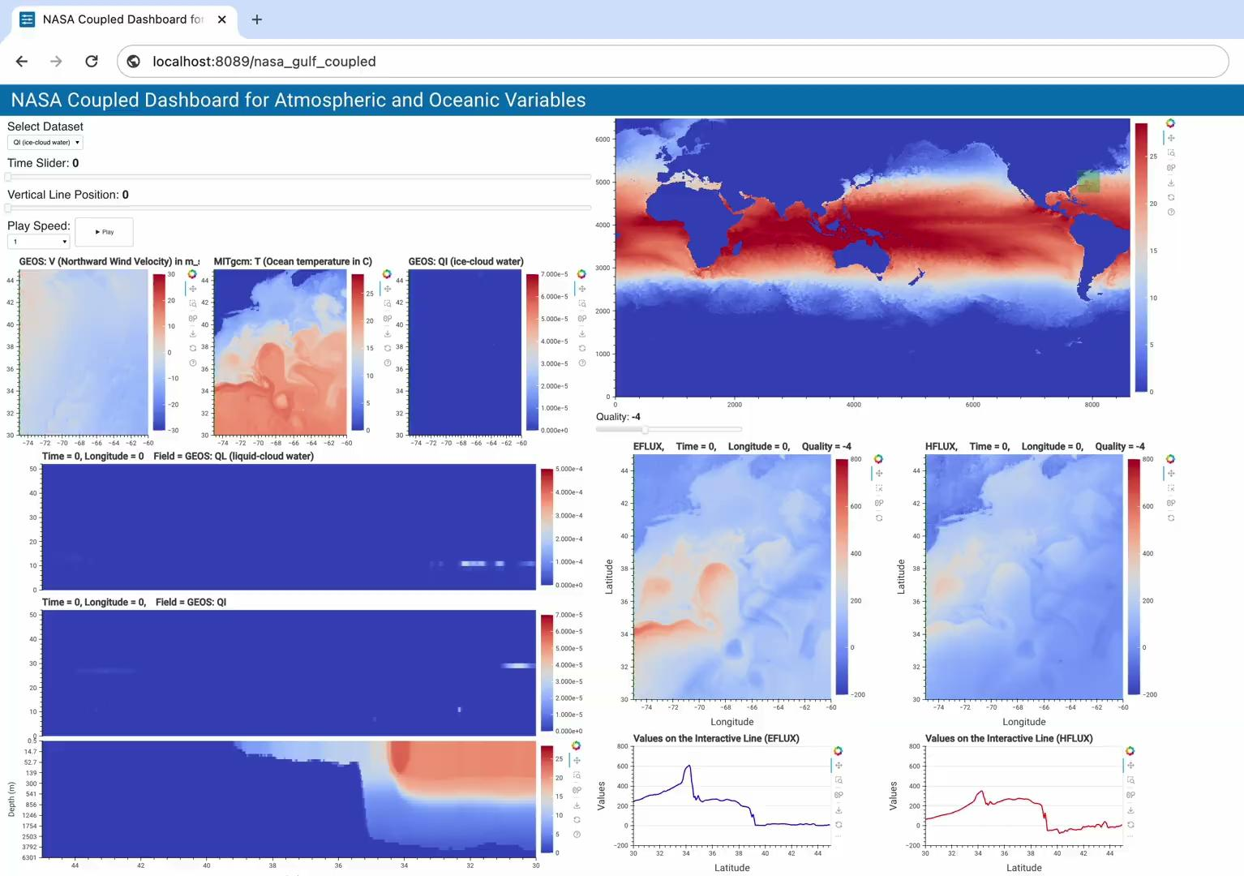
Cloud served optimized data with local caching
Aashish Panta,Xuan Huang, Nina McCurdy, David Ellsworth, Amy A. Gooch, Giorgio Scorzelli, Hector Torres, Patrice Klein, Gustavo A. Ovando-Montejo, Valerio Pascucci.
“Web-based Visualization and Analytics of Petascale data: Equity as a Tide that Lifts All Boats”. LDAV 2024
Notes:
Our dashboards allow users to pick the time slices and resolution and explore the data interactively

Slide 13
Cloud served optimized data with local caching
Github link to access instructions to launch a new dashboard: https://github.com/sci-visus/Openvisus-NASA-Dashboard
Dashboard Like the NASA Animation: http://chpc3.nationalsciencedatafabric.org:11857/run
Notes:
This region-specific approach allows scientists to observe how atmospheric conditions such as temperature and pressure gradients influence oceanic currents, salinity levels, and vertical velocities, and vice versa. Figure~\ref{fig:gulf_usecase} shows how an investigation into an
interesting wave pattern observed in the plots of sensible and latent heat flux (middle) and examination of the associated vertical slices led the ocean scientists to find that the wave pattern was trapped within the atmospheric boundary layer (left) and did not extend above the boundary layer, as previously thought.

Slide 14
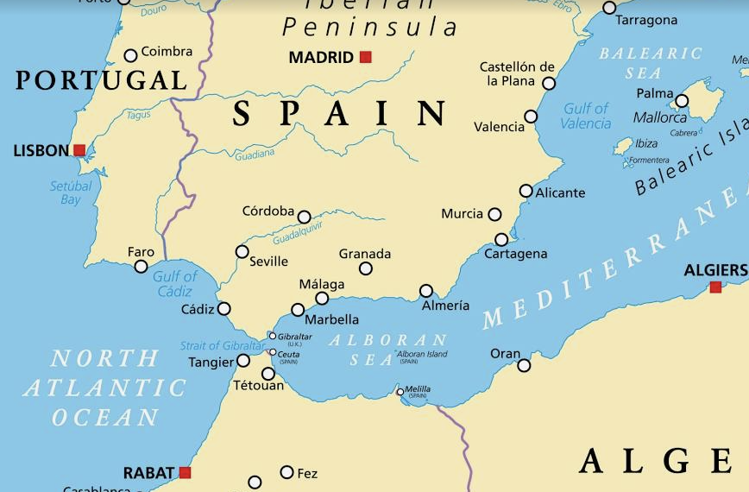
Science of Climate change
The Mediterranean Sea is warming and evaporating more and more with marine heat waves increasing in intensity, duration and frequency
Tracking the changes of the ocean on either side of the Gibraltar Strait is crucial in order to understand the impact of climate change.
Even today, the Mediterranean is considerably saltier than the North Atlantic.
Notes:
Strait of Gibraltar closes again (which is likely to happen in the near future in geological time), the Mediterranean would mostly evaporate in about a thousand years, after which continued northward movement of Africa may obliterate the Mediterranean altogether.

Slide 15
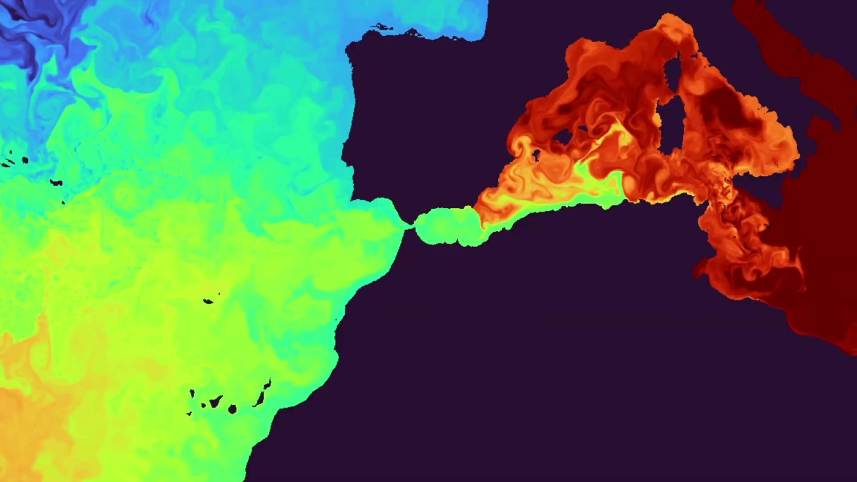
Now you can Visualize the salient changes in the Strait of Gibraltar
Access
petascale
NASA
data
With OpenViSUS we can treat it as a NumPy array.
Tutorial
Head back to Codespaces
Notes:
Our dashboard addresses this challenge by offering progressive visualization capabilities and allows scientists to explore the data seamlessly through an intuitive interface.
For example, this recording of our dashboards shows the interesting phenomenon of water circulation around the Mediterranean region. The less saline water from the Atlantic Ocean passes through the Strait of Gibraltar and starts moving eastward. As the water moves east and the evaporation continues, the salinity tends to increase and starts sinking. Oceanographers and climate scientists worldwide have studied this interesting phenomenon, but no tool has ever allowed its interactive illustration on real data to the general public until now
In the next hands on activity, you will be able to explore the same petascale data by accessing data stored in the cloud thanks to Seal Storage, convert it to OpenViSUS’s IDX format and then load it into a NumPy array.
Please head back to Codespaces you used for the first hands on activity.

Slide 16
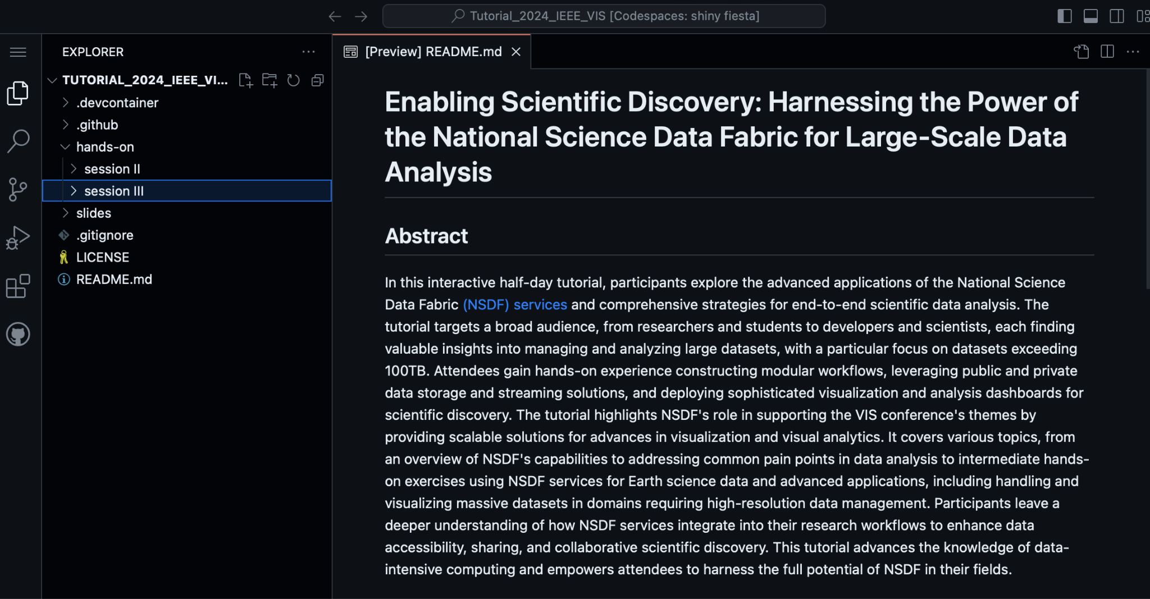
Tutorial
When the codespace is fully loaded, you should see this screen
Notes:
In code spaces, please select Session III (3)

Slide 17
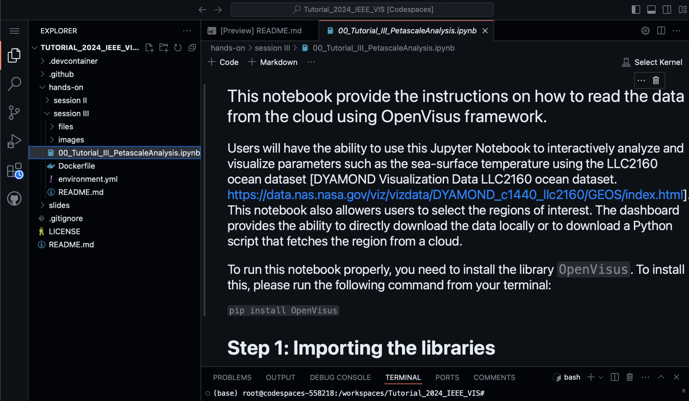
Select the file
.ipynb
using the side bar
Tutorial
Notes:
next select the 00_Tutorial file for Session III (3)

Slide 18
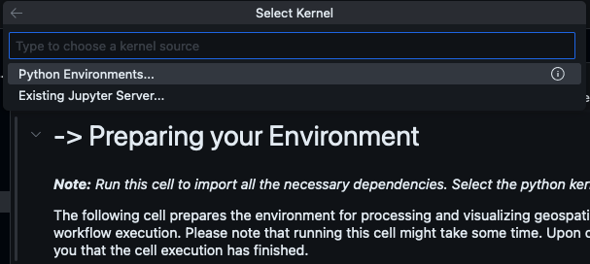
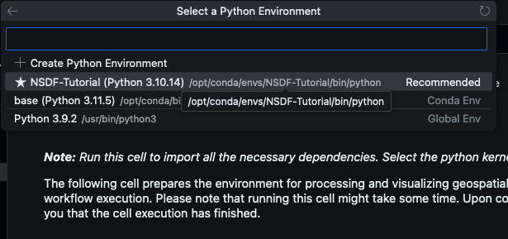
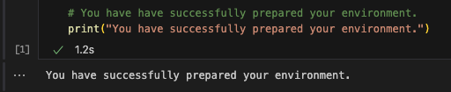
(4) A list to Select Kernel should pop up. Select Python Environments…
Tutorial
(6) Finally, after running the Preparing your Environment cell, you should see a message saying it was successfully prepared
(5) Select the ★NSDF-Tutorial option

Slide 19
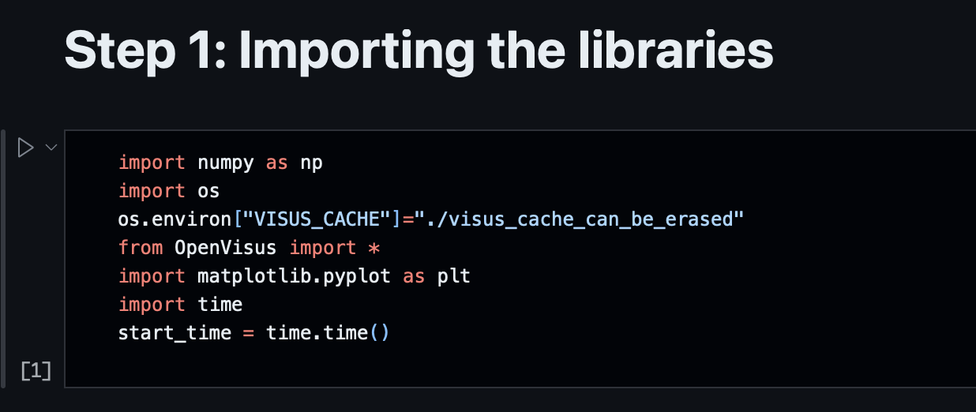
Click on the triangle to play through the
section of Python code
Tutorial
Notes:
< Give introduction again to on how to run the sections by clicking on the “play” arrow on the left hand side >
<<< Now switch over to code spaces and run through the hands on tutorial with them >>>

Slide 20

Dashboard 1
Run it yourself
Notes:
Our dashboard addresses this challenge by offering progressive visualization capabilities and allows scientists to explore the data seamlessly through an intuitive interface.
For example, Figure \ref{fig:salinity_med} shows the interesting phenomenon of water circulation around the Mediterranean region. The less saline water from the Atlantic Ocean passes through the Strait of Gibraltar and starts moving eastward. As the water moves east and the evaporation continues, the salinity tends to increase and starts sinking. Oceanographers and climate scientists worldwide have studied this interesting phenomenon, but no tool has ever allowed its interactive illustration on real data to the general public until now

Slide 21
Try it yourself:
Using the NASA LLC2160:
https://github.com/nsdf-fabric/Tutorial_2024_IEEE_VIS/blob/main/notebooks/OpenVisus_NASA_Gustavo2.ipynb
Create a Dashboard:
https://github.com/sci-visus/Openvisus-NASA-Dashboard

Slide 22
Hands on..
Tutorial
When finished with
00_Tutorial_III_PetascaleAnalysis.ipynb
You can go to next set of investigations on your own…
(next slide)

Slide 23
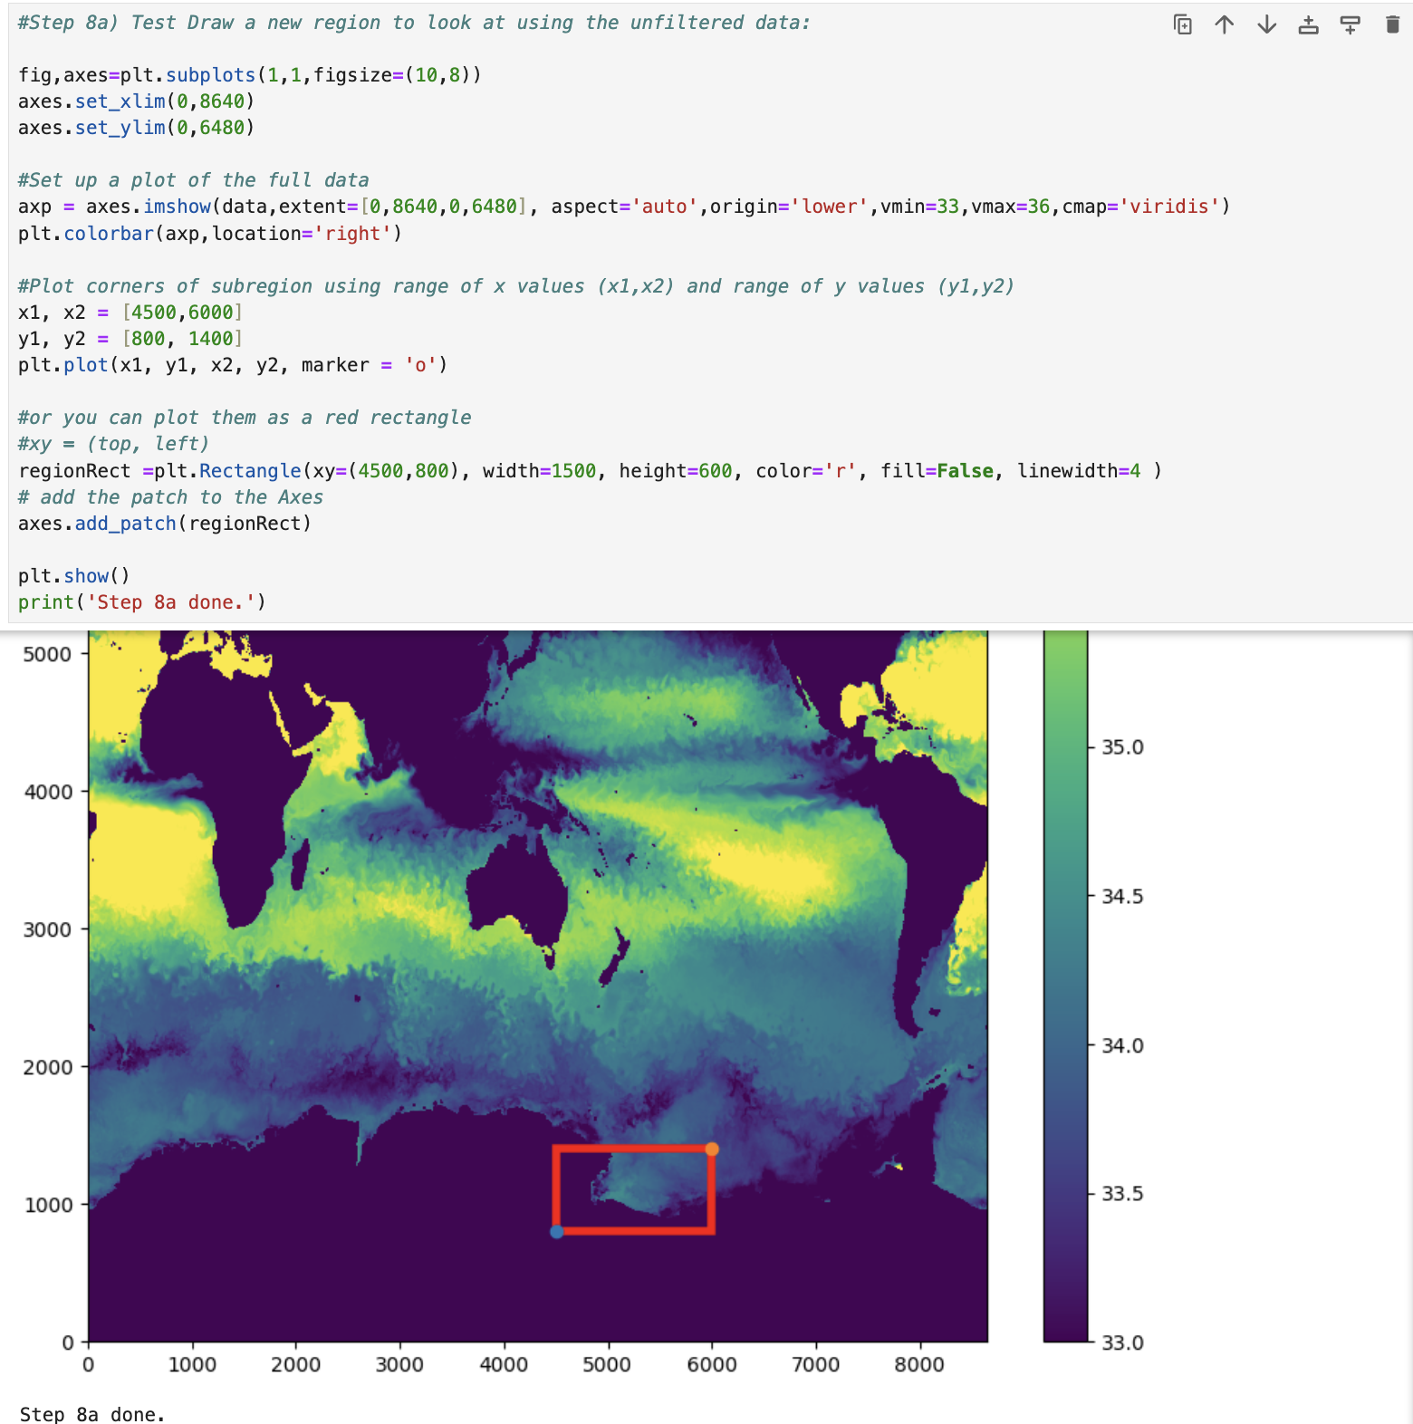
Be Curious!
Change the
Jupyter Notebook:

Slide 24
Be Curious! Change the Jupyter Notebook:
Can you visualize the min and max salinity in the Straits of the Gibraltar at a particular time?
HINT: Maybe look at two regions, one on Atlantic side, one in the Mediterranean
What is the min/max over a section of time?
Notes:
Other potential questions for them to examine…

Slide 25
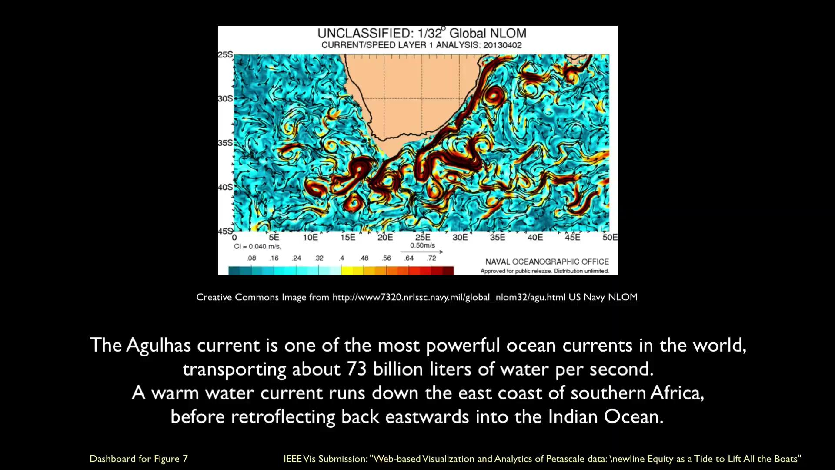
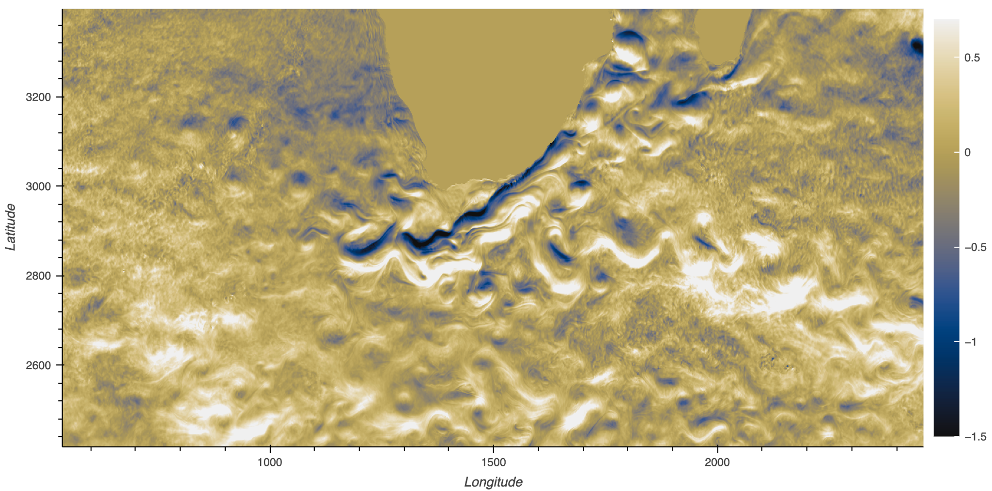
More Domain Science!
What is the maximum E-W current of the Aghulas Rings (currents) off the southern tip of South America?

Slide 26
All Hands Advanced Tutorial Option:
Tutorial
First:
Change the dataset you load in Step 2 to load
eastwest_ocean_velocity_u
Next:
Change the region of interest in Step 8 to the southern tip of Africa
What is the maximum E-W current of the Aghulas Rings (currents) off the southern tip of South Africa?

Slide 27
Now you have all these datasets
How do you
organize?
share?
view?
archive?

Slide 28

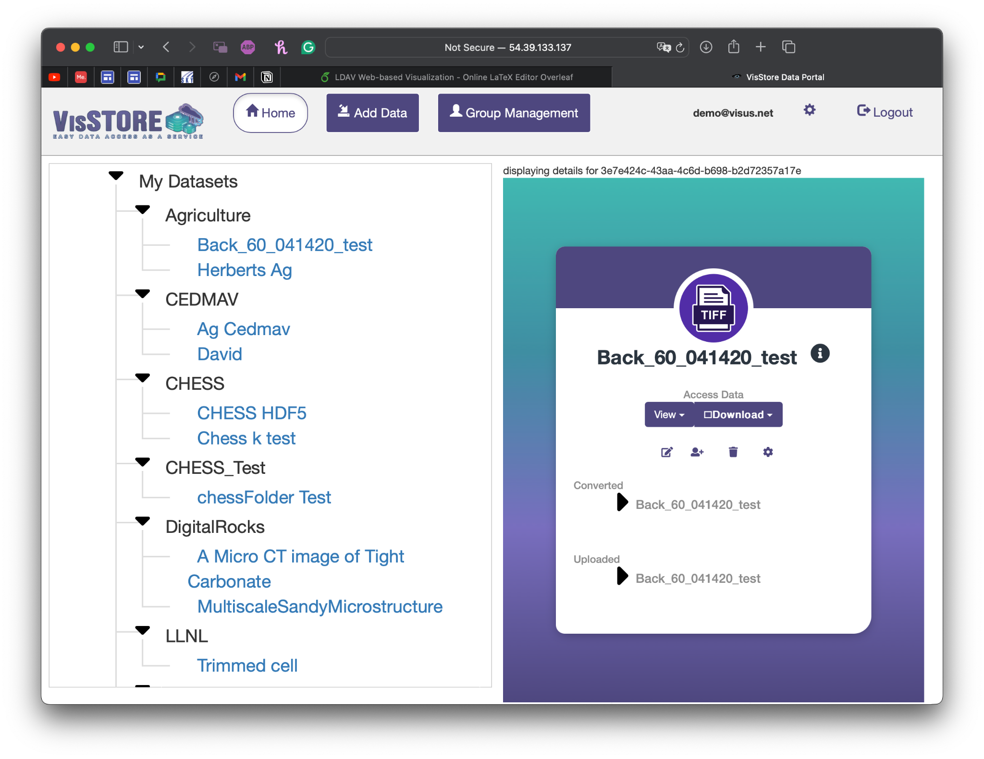
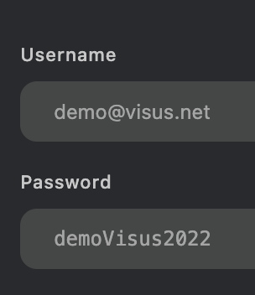
Demo: set url in browser to: http://54.39.133.137/
Create your own login to
upload your own data
or use:
Notes:
Tutorial: https://docs.google.com/presentation/d/1yJYGtHR8SiiXWd6R7QKtLDPTq3ylWEmYHjwD8iW_SNc/edit#slide=id.g2eb587680a8_0_20

Slide 29
Session III: Other Datasets
Democratizing Access and Use of Large-scale Data

Slide 30




Check Out Other NSDF-Dashboards
QR1: NASA Ocean Dataset Use Case
QR3: Material Science Use Case
QR2: CHESS Use Case
QR4: Bellows Use Case

Slide 31
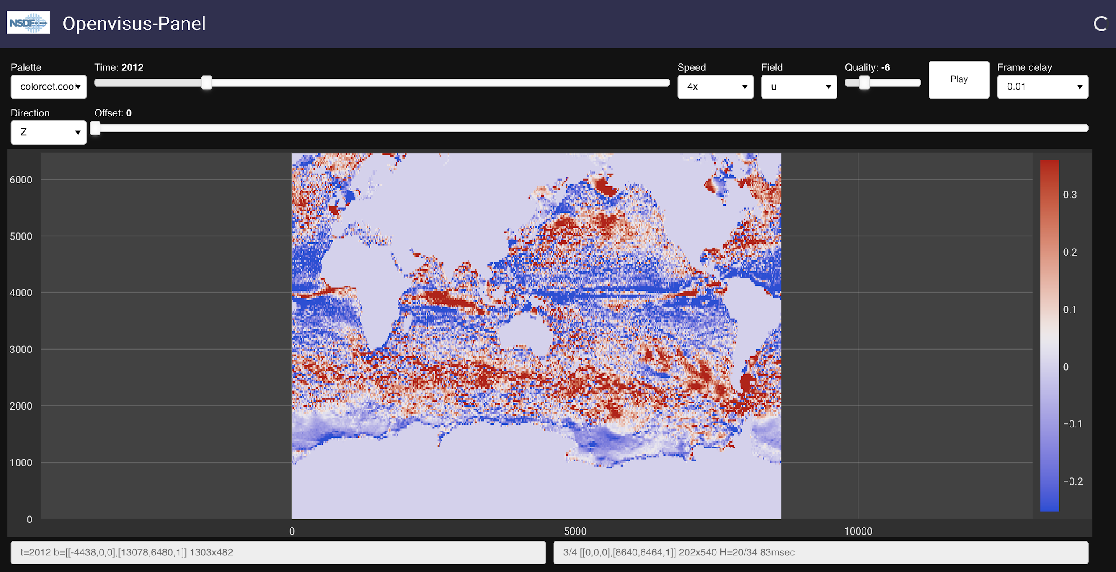
Check Out Other NSDF-Dashboards (I)
NASA Ocean Dataset Use Case

Slide 32
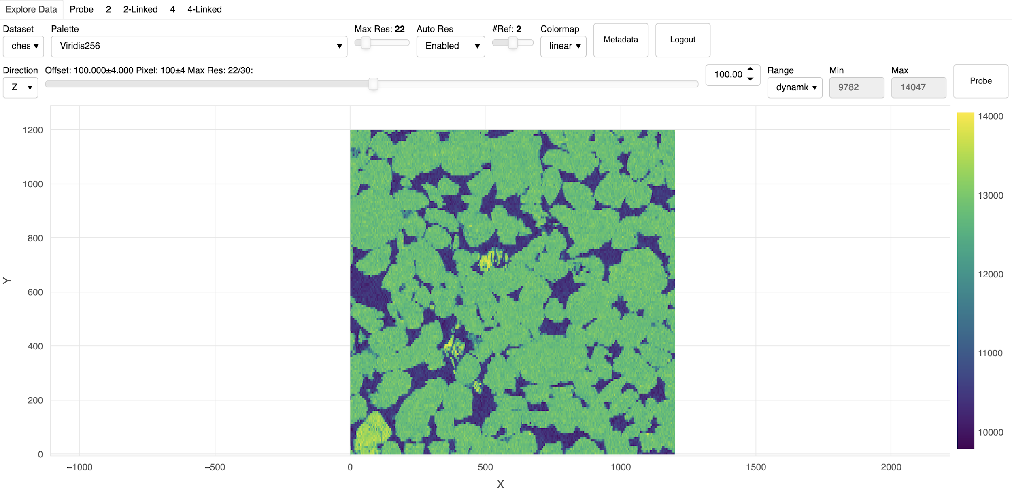
Check Out Other NSDF-Dashboards(II)
CHESS Use Case

Slide 33
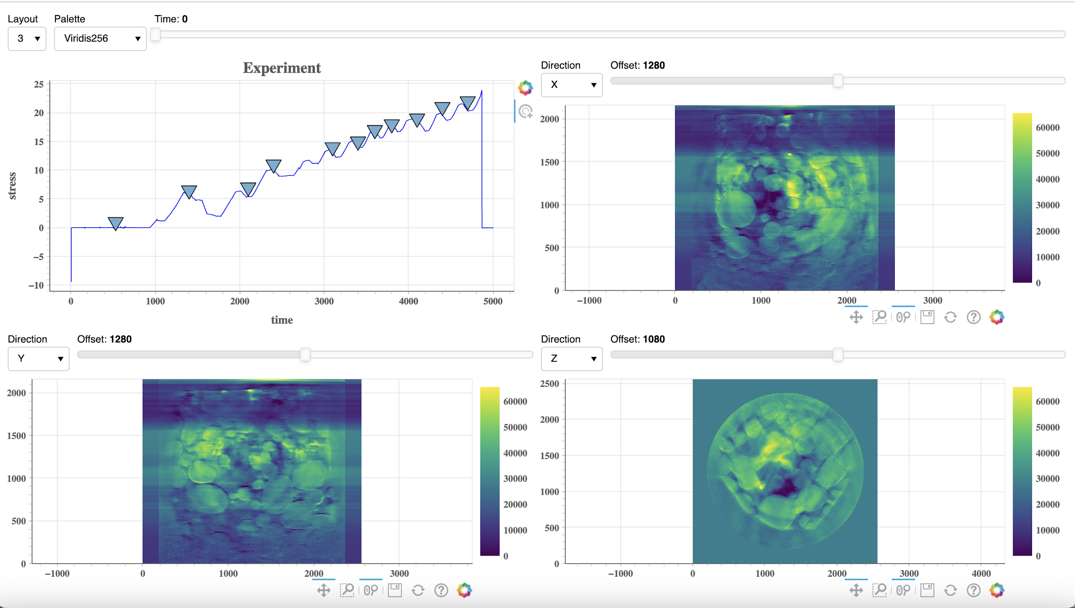
Check Out Other NSDF-Dashboards (III)
Materials Science Use Case

Slide 34
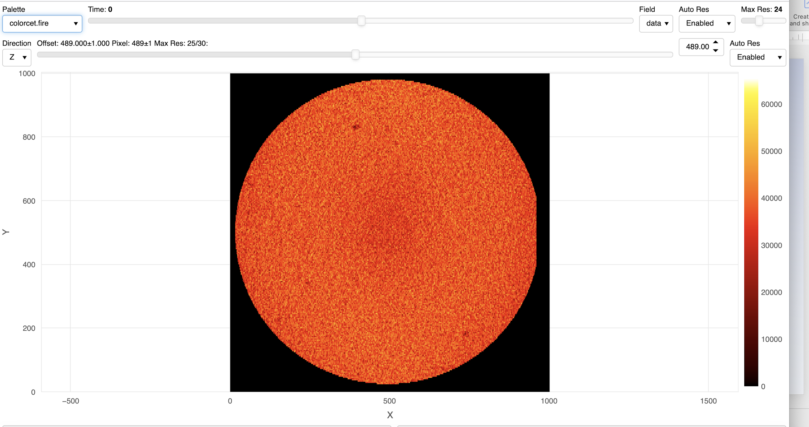
Check Out Other NSDF-Dashboards (I)
Bellows
Dataset Use Case

Slide 35
Part IV: Discussion with Tutorial Attendees
Democratizing Access and Use of Large-scale Data

Slide 36
From Theory to Practice
Construct a modular workflow that combines your application components with NSDF services
Is your application modular? Can you leverage APIs?
Can your application take advantage of the NSDF services?
Upload, download, and stream data to and from public and private storage solutions
How large is your data? How do you access, share, and store your data?
Can your data take advantage of private and public storage?
Deploy the NSDF dashboard for large-scale data access, visualization, and analysis
What type of analysis do you perform on your data?
Can your research take advantage of an interactive dashboard?

Slide 37





Tutorial Links
NSDF-Tutorial
GEOtiled
VisStore
SOMOSPIE
OpenVisus
ViSOAR

Slide 38

Survey
Share your thoughts with us! (3 mins)
https://shorturl.at/jYBxS

